Slide 1
Activation function
An activation function in a neural network defines how the weighted sum of the input is transformed into an output from a node or nodes in a layer of the network

Slide 2
1 . Sigmoid
It is one of the most widely used non-linear activation function. Sigmoid transforms the values between the range 0 and 1. Here is the mathematical expression for sigmoid-
f(x) = 1/(1+e^-x)

Slide 3
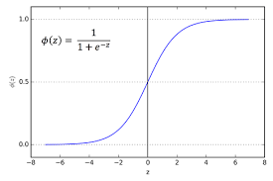

Slide 4
2. Tanh
The tanh function is very similar to the sigmoid function. The only difference is that it is symmetric around the origin. The range of values in this case is from -1 to 1. Thus the inputs to the next layers will not always be of the same sign. The tanh function is defined as- tanh(x)=2sigmoid(2x)-1

Slide 5
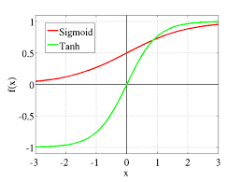
tanh(x)=2sigmoid(2x)-1

Slide 6
3. ReLU
ReLU stands for Rectified Linear Unit. The main advantage of using the ReLU function over other activation functions is that it does not activate all the neurons at the same time.
This means that the neurons will only be deactivated if the output of the linear transformation is less than 0. The plot below will help you understand this better-f(x)=max(0,x)

Slide 7
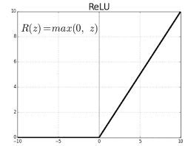
For the negative input values, the result is zero, that means the neuron does not get activated. Since only a certain number of neurons are activated, the ReLU function is far more computationally efficient when compared to the sigmoid and tanh function

Slide 8
4. Leaky ReLU
Leaky ReLU function is nothing but an improved version of the ReLU function. As we saw that for the ReLU function, the gradient is 0 for x<0, which would deactivate the neurons in that region.
Leaky ReLU is defined to address this problem. Instead of defining the Relu function as 0 for negative values of x, we define it as an extremely small linear component of x. Here is the mathematical expression-
f(x)= 0.01x, x<0
= x, x>=0

Slide 9
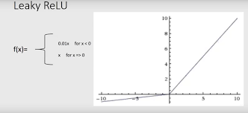
By making this small modification, the gradient of the left side of the graph comes out to be a non zero value. Hence we would no longer encounter dead neurons in that region

Slide 10
5.Softmax
Softmax function is often described as a combination of multiple sigmoids. We know that sigmoid returns values between 0 and 1, which can be treated as probabilities of a data point belonging to a particular class. Thus sigmoid is widely used for binary classification problems.
The softmax function can be used for multiclass classification problems. This function returns the probability for a datapoint belonging to each individual class. Here is the mathematical expression of the same-

Slide 11
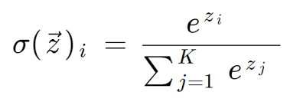
1.While building a network for a multiclass problem, the output layer would have as many neurons as the number of classes in the target. For instance if you have three classes, there would be three neurons in the output layer. Suppose you got the output from the neurons as [1.2 , 0.9 , 0.75].
2.Applying the softmax function over these values, you will get the following result – [0.42 , 0.31, 0.27]. These represent the probability for the data point belonging to each class. Note that the sum of all the values is 1.

Slide 12
